Slide 1

Red, Green, Refactor
Test and Data Driven Development in Kotlin
Notes:
I’m Erik Pohl, and I’m presenting on going from Test Driven Development to Data Driven Development in Kotlin. I’ll tell you more about myself later…

Slide 2

DISCLAIMER
So let it be disclaimed.
These slides are wordy.
You don’t have to read every word during the presentation.
Sit back, enjoy, and come back to this deck if you want.

Slide 3
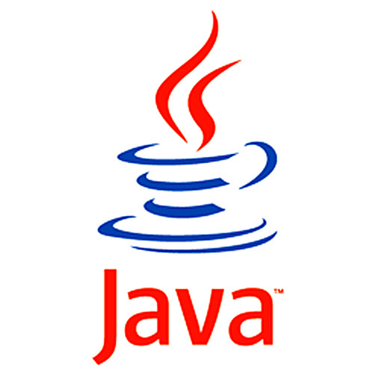

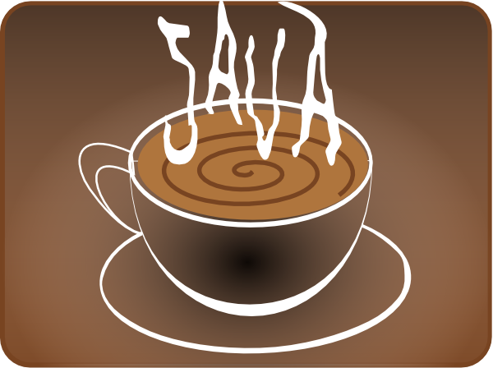
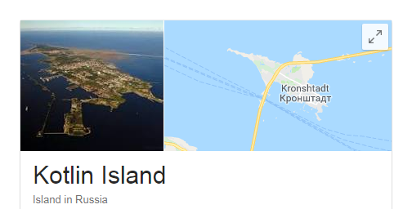
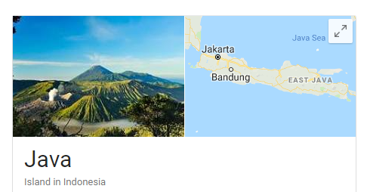
Trivia
Notes:
I thought this was cool.

Slide 4
Assumption: Beginner familiarity with Kotlin development [all I have!]
Libraries used in this presentation: kotlintest
Cultural references (and potential to take a sip of your water or beverage during the presentation whenever you spot the reference):
Psy,
Kubrick,
MC Hammer,
Jaws (1975),
Monty Python,
Right Said Fred,
DC comics,
Back to the Future (1985),
Austin Powers [circa 1999]
What you will learn if you don’t already know it:
beginner usage of kotlintest module
the rudiments of Test Driven Development
the rudiments of Data Driven Development

Slide 5
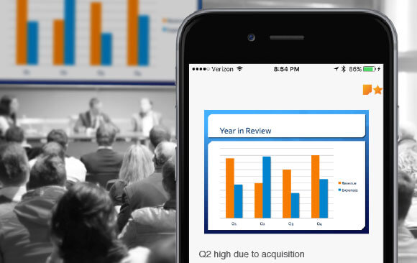
I WILL SHARE THE SLIDE DECK VIA THE MEETUP AFTER TONIGHT’S PRESENTATION

Slide 6

How not to do it, or “Red”
As written by someone who has done it this way

Slide 7
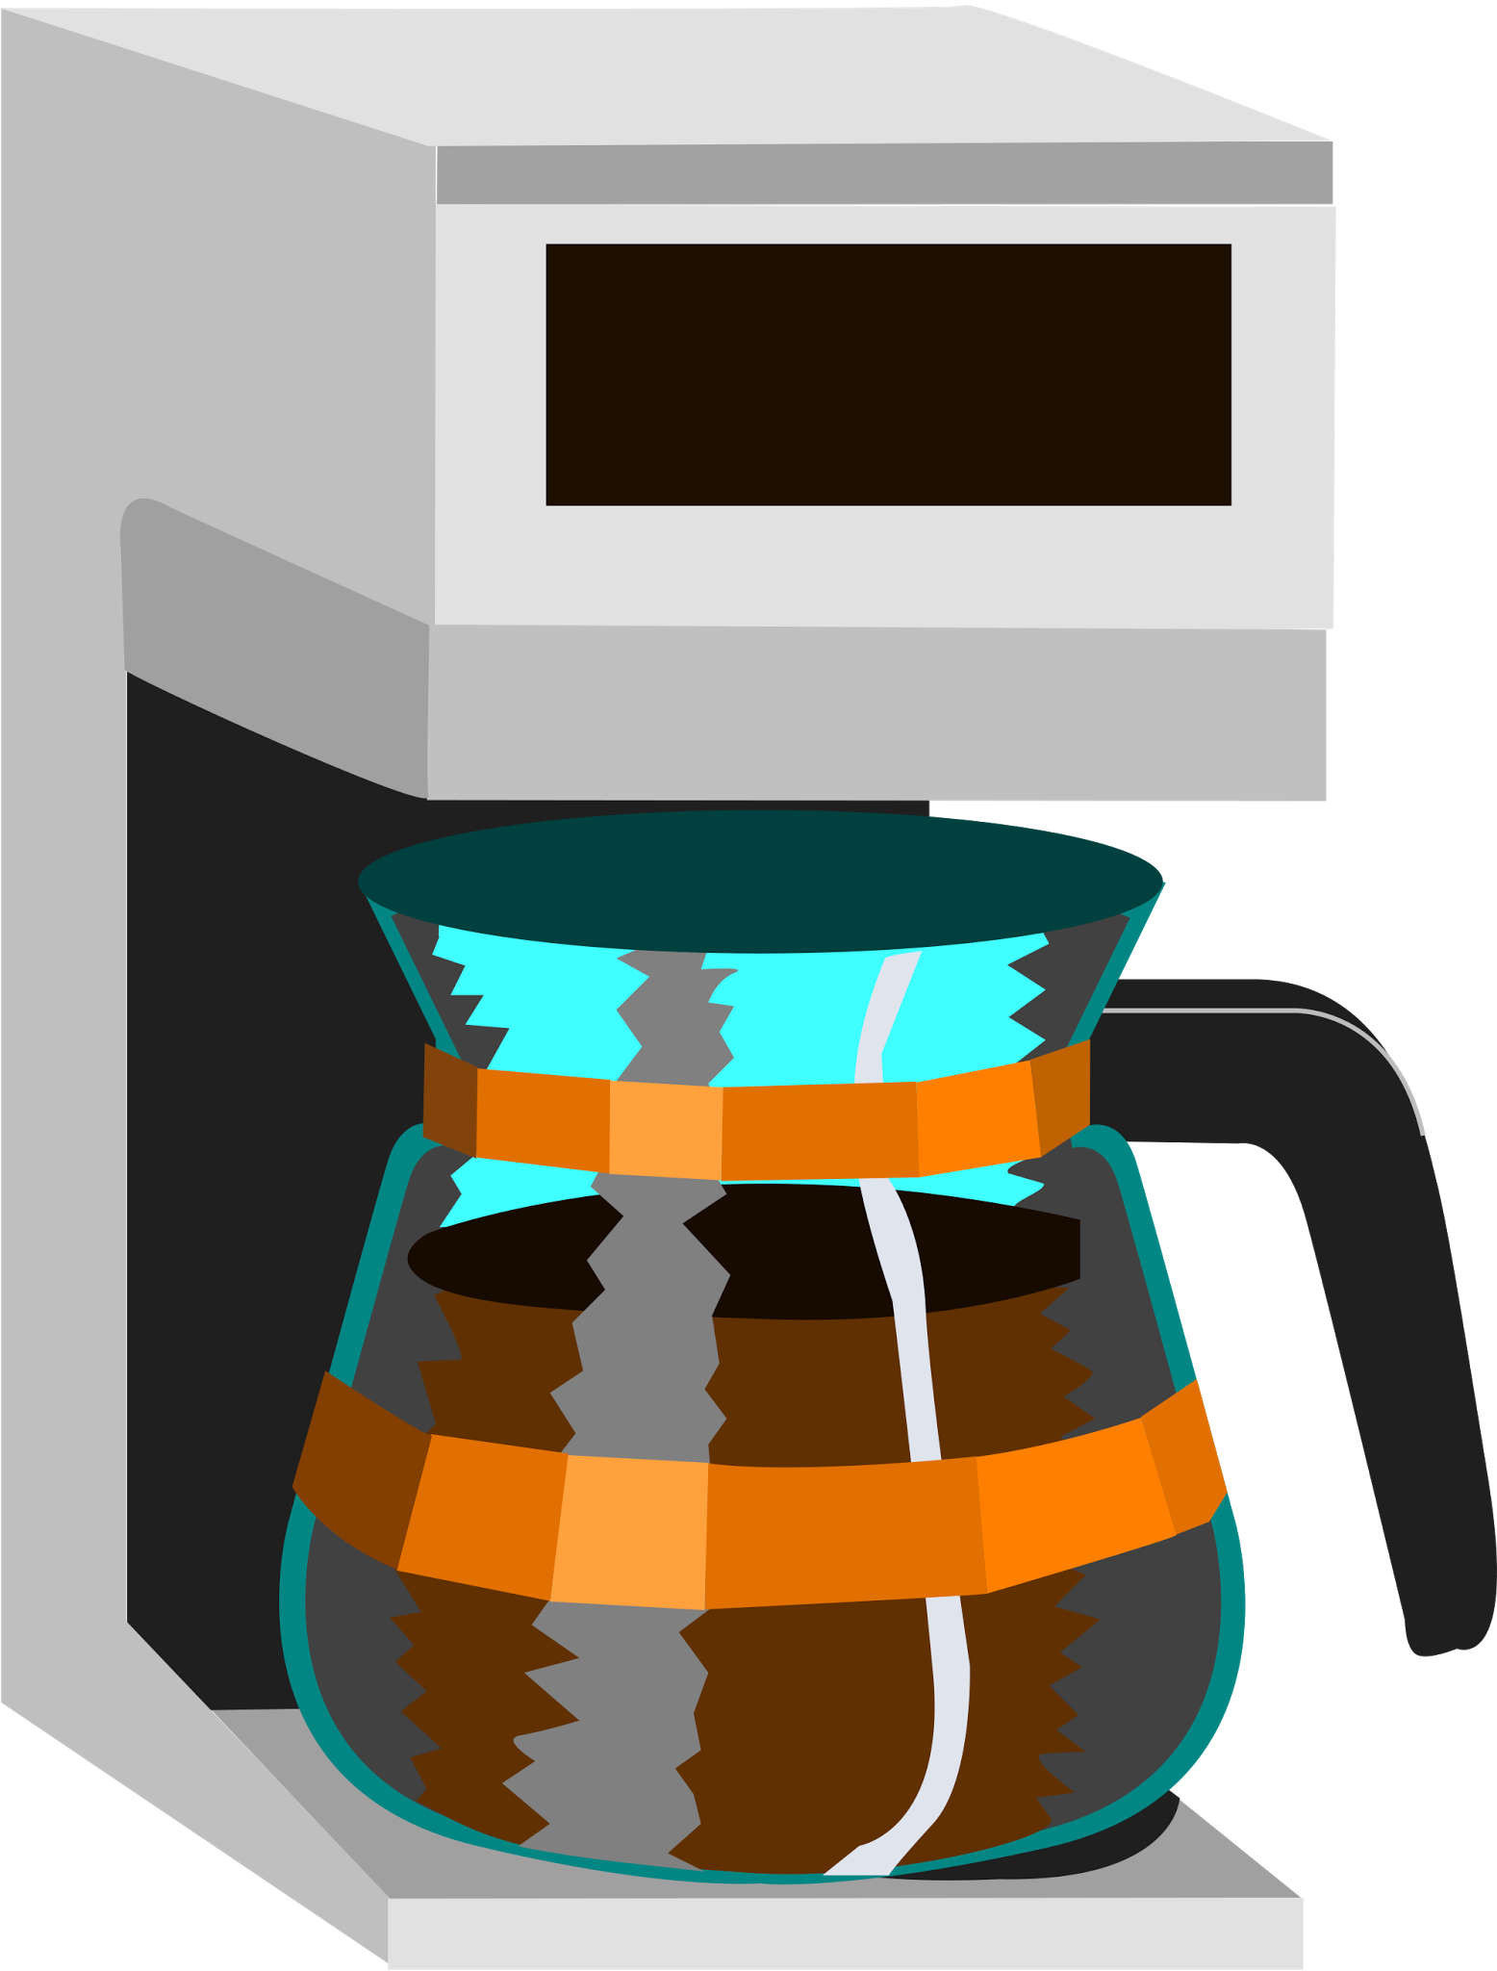
What the business wants from dev team 1
“Development team 2 needs a coffee maker so they can develop code.”
(Why not just buy it rather than make it? We want to drink our own drip coffee!)
It accepts X cups of water, an empty glass carafe, dry ground coffee beans, and a clean coffee filter as input.
It makes X cups of coffee as output.
You can program it to start making the coffee at 8am.
You can turn it off.

Slide 8
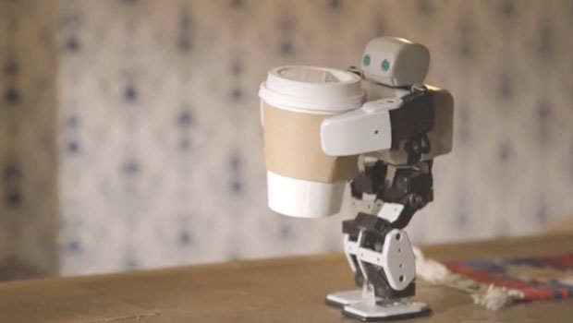
What the dev team 1 engineers give the business
“Development team 2 needs a coffee maker so they can develop code.”
It accepts X cups of water, an empty glass carafe, dry ground coffee beans, and a clean coffee filter as input.
It makes X cups of coffee as output.
You can program it to start making the coffee at 8am.
You can turn it off. "I'm sorry Dave, I'm afraid I can't do that.”
Side effects:
You didn’t test one of the requirements.
The product is 2 years late and development team 2 hasn’t developed any code in those 2 years.
You are now depleting the world’s supply of coffee beans, empty glass carafes, clean coffee filters, and water at a rate which alarms the world governments, leading to an armed conflict to terminate the product.

Slide 9

Test Driven Development, or “Green”
Not not doing the right thing

Slide 10

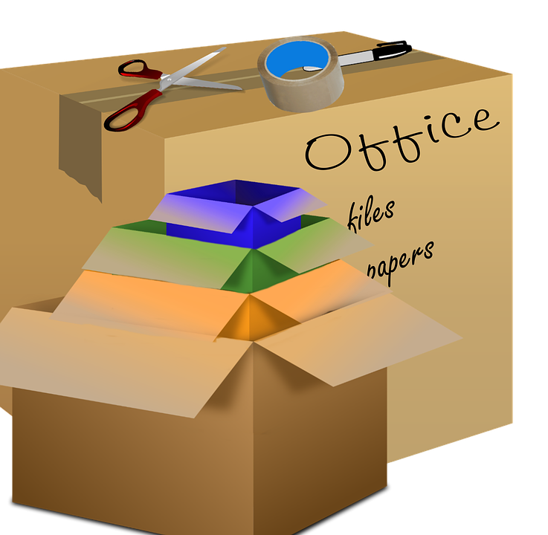
Test Driven Development basics: for each test case
Red. You have not written solution code yet. Based solely on your user requirements, you create a test case. This case will fail because you have not written solution code yet.
Why? The focus is on building a suite of tests which are specifically geared to test user requirements and nothing else.
If you do that first, you will not not do it.
Green. You write the simplest code to pass the test possible. Don’t get fancy.
If your AI named Hal will return: “I'm sorry, Dave. I'm afraid I can't do that.” when you ask it to open the pod bay doors, hard code the response to get the test to pass.
Why? The focus is on building software which will pass the user requirements. If you do this first, you will not not do it.
Refactor. You clean the code and make it organized and simple without changing the results. Take a cluttered box you are moving, organize it, and tape it up. Same stuff, same output when you open it later, just organized, efficient.
Why? We wouldn’t be engineers if we didn’t want to take out the ugly code. We want to make this code perform well and be efficient. We don’t want to break our test cases. Here’s where you change the brute force green code to something you can show your boss.

Slide 11
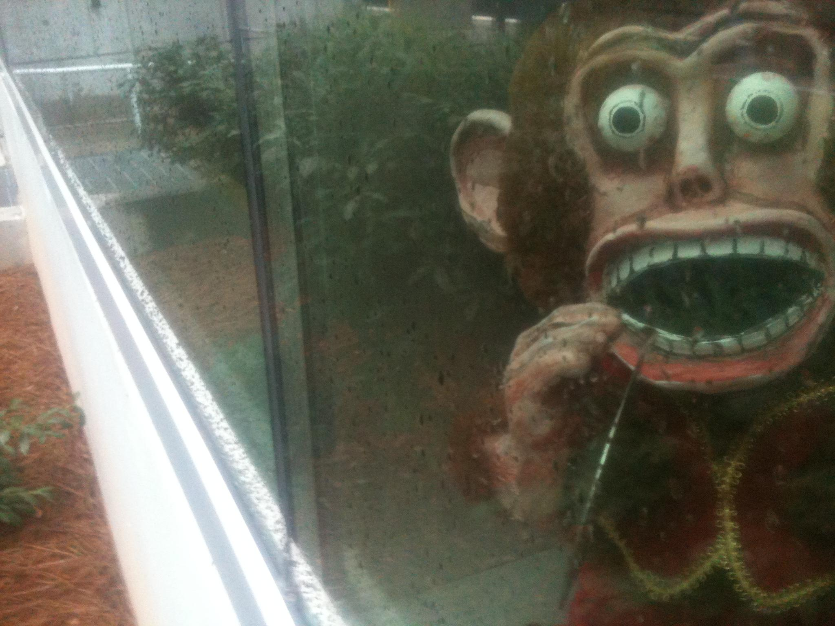
Whew! That was a lot all at once!

Slide 12
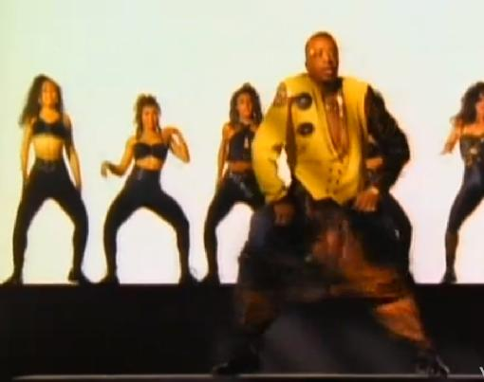
No problem. Break it down!

Slide 13
Red
Red.
You have not written solution code yet.
In fact, you might have no solution code at all!
Based solely on your user requirements, you create a test case.
This case will fail because you have not written solution code yet.
Why? The focus is on building a suite of tests which are specifically geared to test user requirements and nothing else.
If you do that first, you will not not do it.

Slide 14
Green
Green.
You write the simplest code to pass the test possible.
Don’t get fancy.
Don’t be too sexy for your requirements.
If your AI named Hal will return: “I'm sorry, Dave. I'm afraid I can't do that.” when you ask it to open the pod bay doors, hard code the response to get the test to pass.
Why? The focus is on building software which will pass the user requirements. If you do this first, you will not not do it.

Slide 15
Refactor
Refactor.
You clean the code and make it organized and simple without changing the results.
Take a cluttered box you are moving, organize it, and tape it up.
Same stuff, same output when you open it later, just organized, efficient.
Why?
We wouldn’t be engineers if we didn’t want to take out the ugly code.
We want to make this code perform well and be efficient.
We don’t want to break our test cases.
Here’s where you change the brute force green code to something you can show your boss.

Slide 16
Not not doing something means you do it
1. You build a suite of test cases for each user requirement
2. This suite, because you built it, can be used for regression testing
3. You only commit code which passes all test cases in the suite
4. You only built code which was explicitly tied to a test case and a requirement

Slide 17
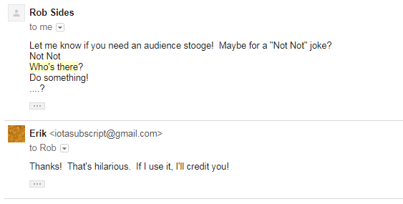
Not not?

Slide 18
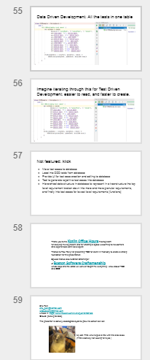
Looking ahead! Almost 70 slides?
“We’re going to
need a bigger
boat.”

Slide 19
A step by step demo is helpful
katas are recommended to learn TDD

Slide 20
Object Oriented Battleship!
There is a single dimensional list of numbers.
Some numbers contain Java ships.
Some numbers contain Kotlin ships.
And some numbers contain Groovy ships.
[ ][ ][ ][ ][ ][ ][ ][ ][ ][ ][ ][ ][ ]...

Slide 21
Object Oriented Battleship!
[1][2][3][4][5][6][7][8][9][10][11][12 ][13 ]...
The rules are simple: each language navy takes a turn.
It guesses a number. It keeps guessing until it sinks at least one ship from the next navy. It does not sink ships from other navies on the same number, even if they occupy the same space.

Slide 22
Now, to familiarize ourselves with the ships in Object Oriented Battleship!

Slide 23
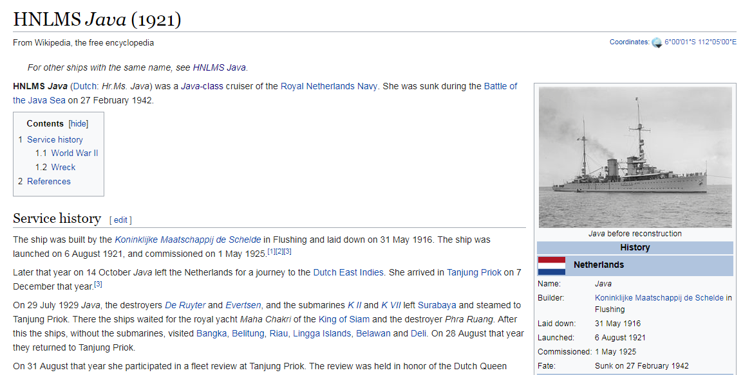
Java-class cruiser HNLMS Java
Occupies even spaces

Slide 24
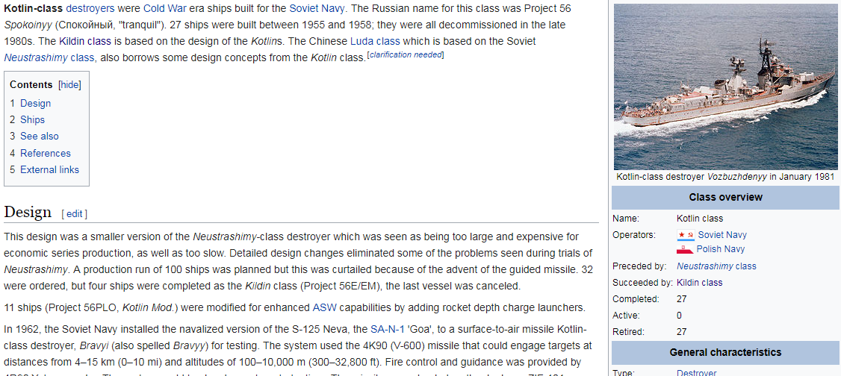
Kotlin-class destroyer Smyshlenyy “Quick Witted”
Occupies odd numbers

Slide 25
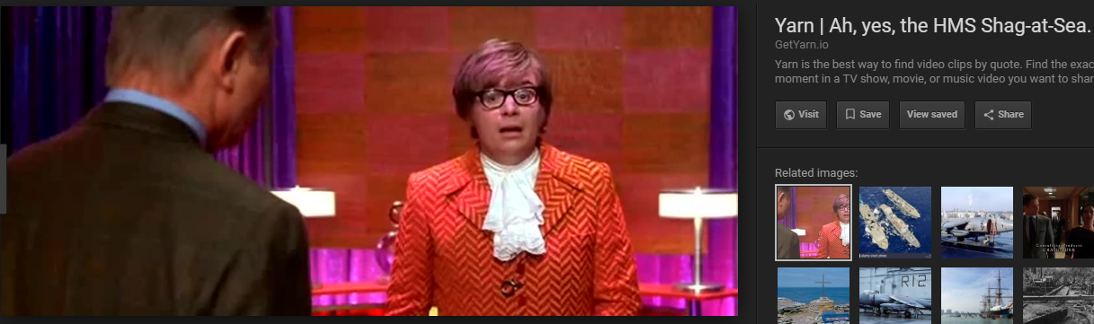
Groovy’s HMS Shag-at-Sea
Occupies Fibonacci numbers

Slide 26
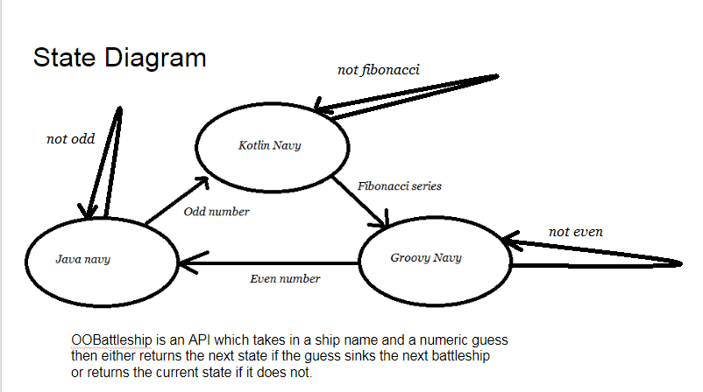
State Diagram

Slide 27
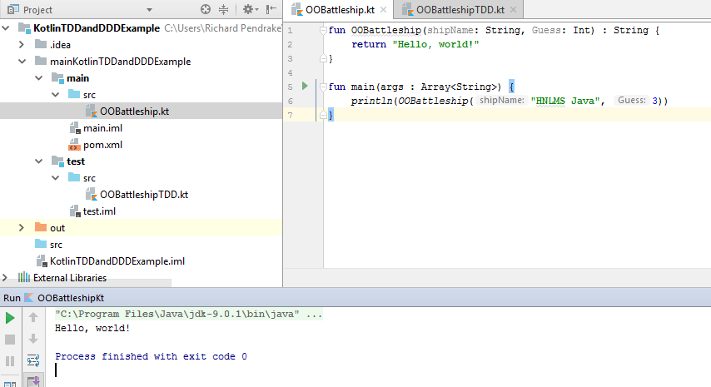
To start with, we have code which does nothing

Slide 28

And developers waiting for failing test case

Slide 29
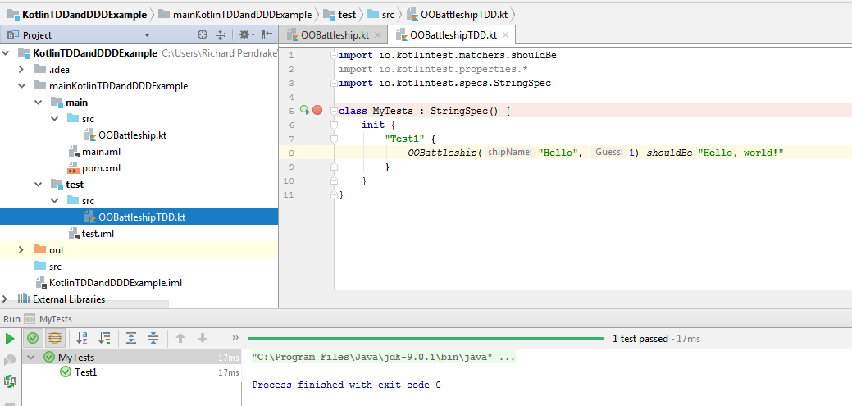
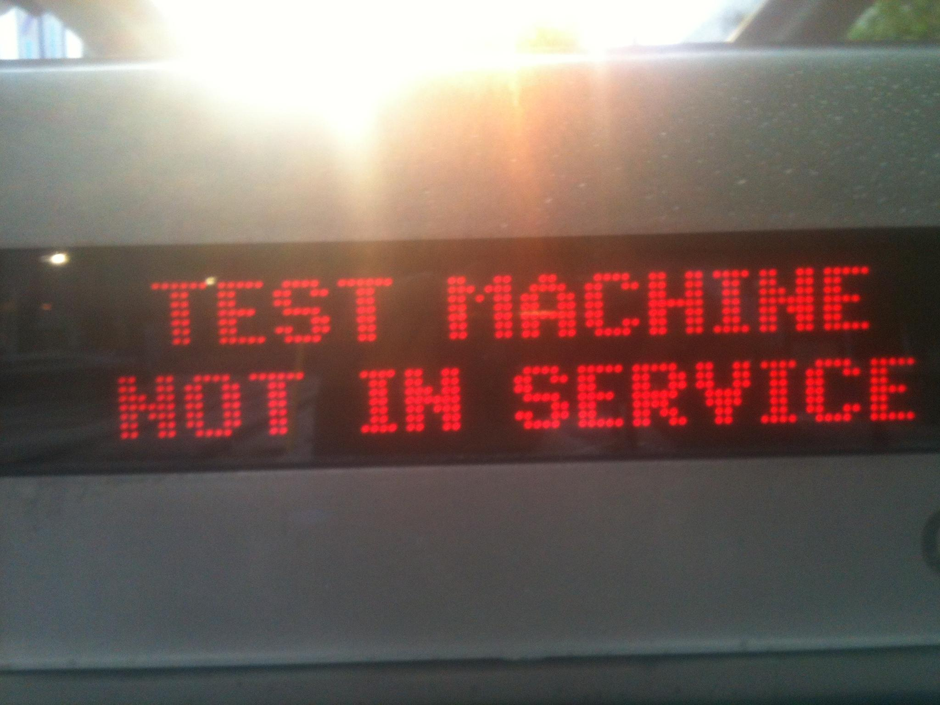
We also have a framework for testing...
without any useful test cases!

Slide 30
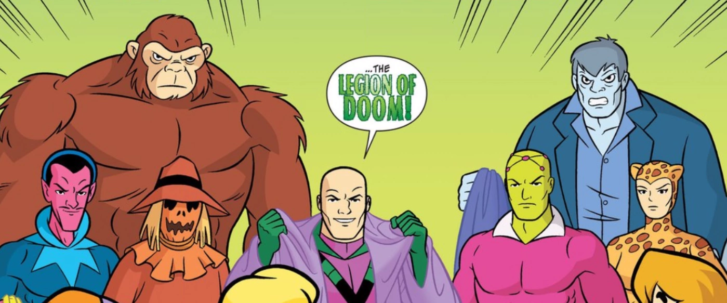
And testers ready to create failing test cases [bwah ha ha ha]

Slide 31
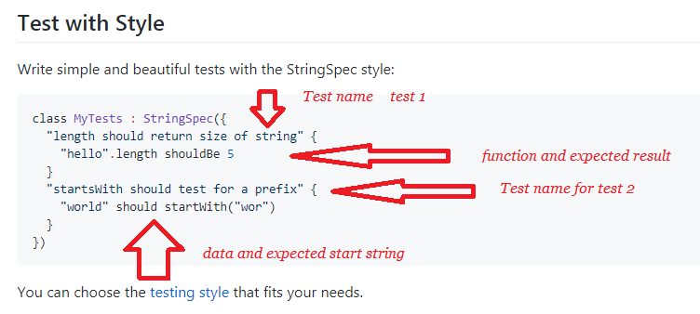
The testers have kotlintest StringSpec style…
maybe even kotlintest Gangnam Style?

Slide 32
AND… we’re off!

Slide 33

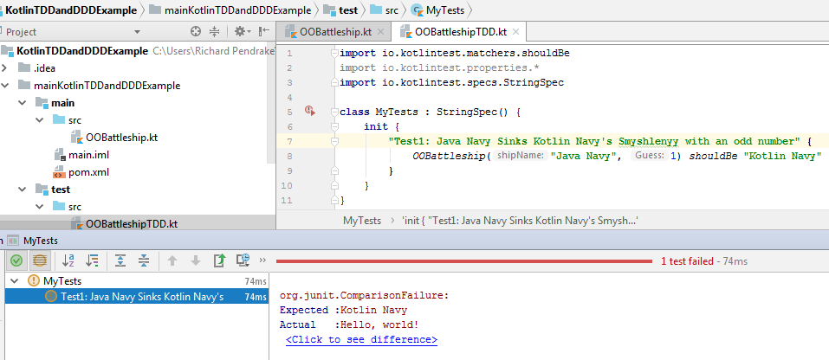
Add a real test, then watch it fail!

Slide 34
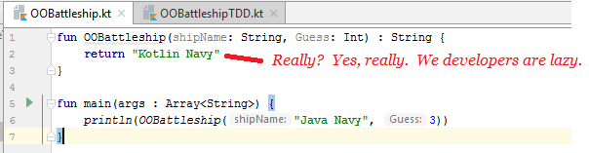
Write just enough code to make it pass the test

Slide 35
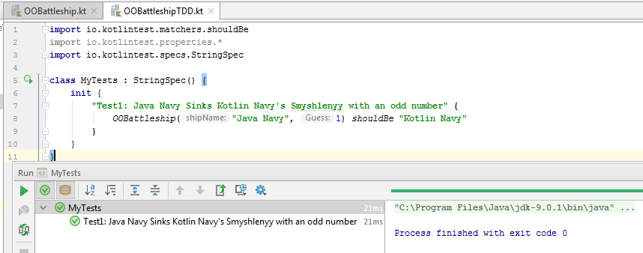
Retest to get to green

Slide 36
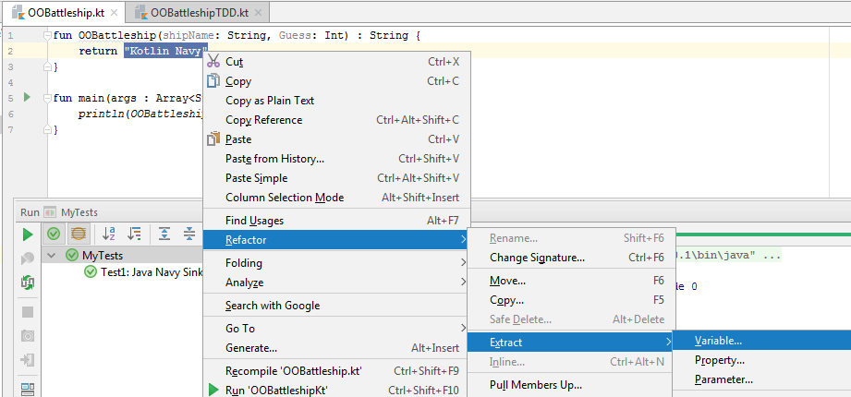
Refactor

Slide 37
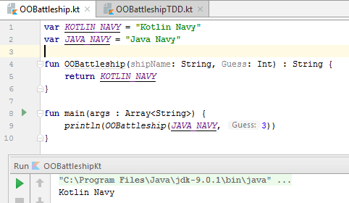
Done?

Slide 38
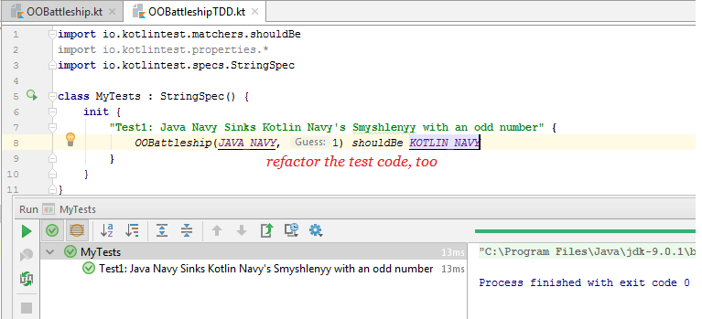
Nope. After refactor, always test to green

Slide 39
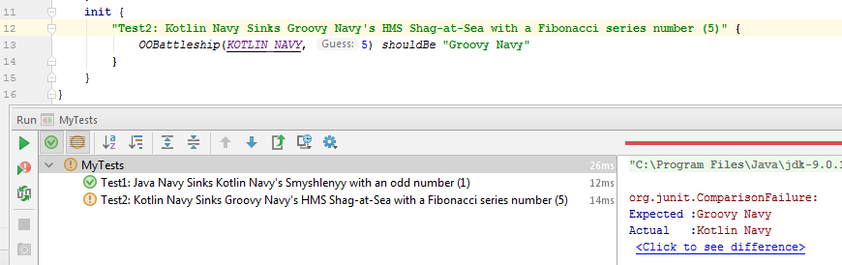
Ok, back to Red: Make a test case to fail

Slide 40
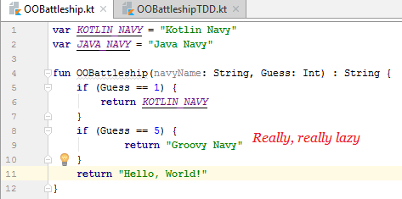
Write just enough code to make it pass the test

Slide 41
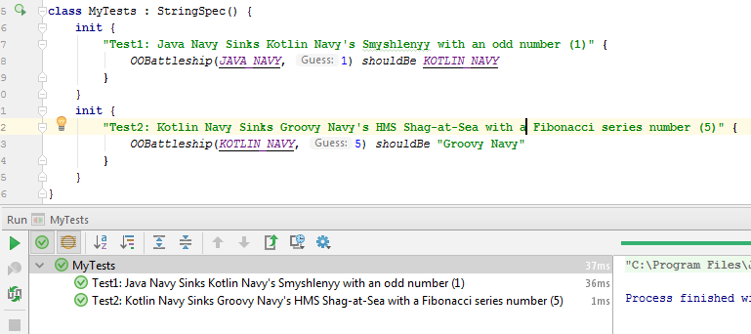
Retest to get to green

Slide 42
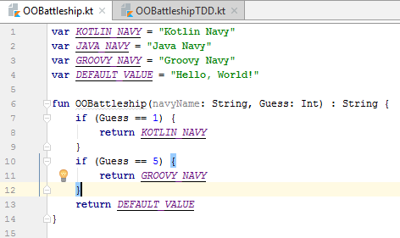
Refactor

Slide 43
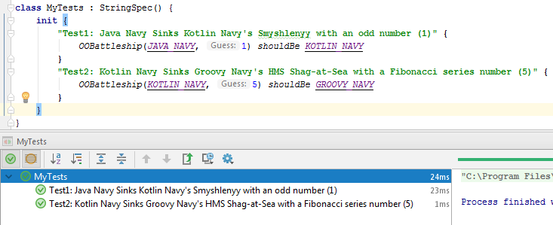
After refactor, always test to green

Slide 44
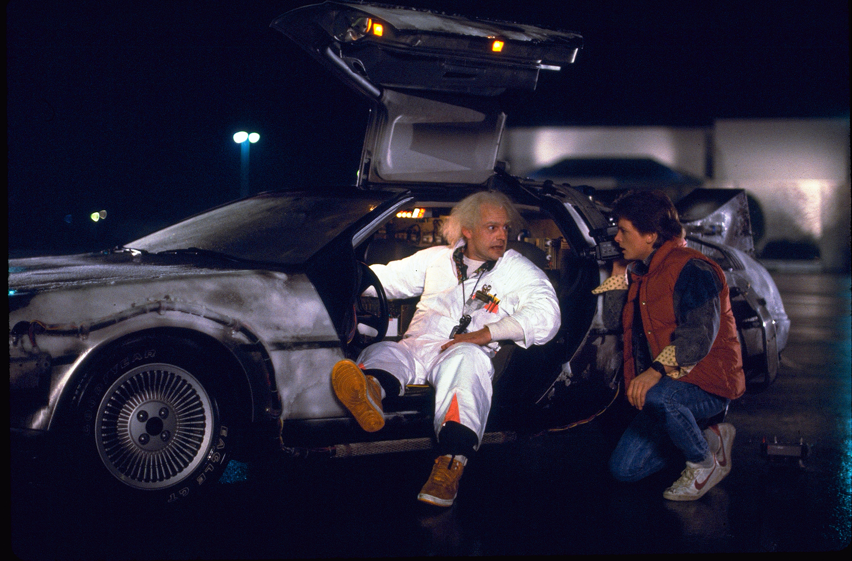
And, let’s skip ahead in time

Slide 45
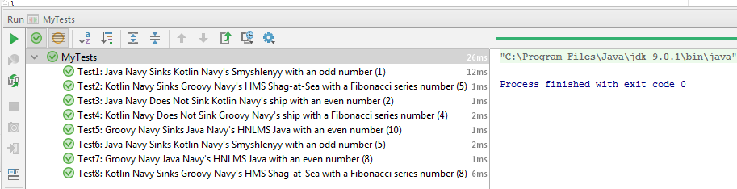
Retest to get to green

Slide 46
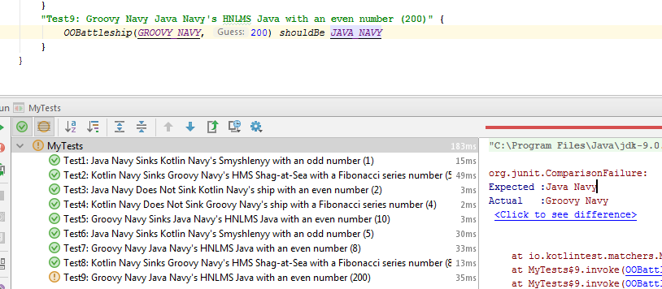
Ok, back to Red: Make a test case to fail

Slide 47
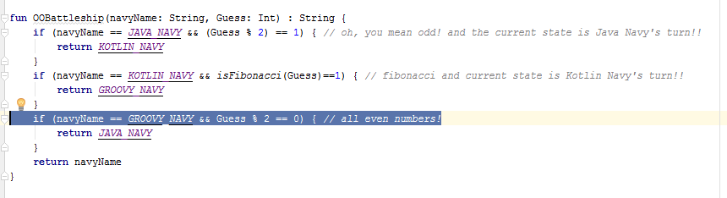
Write just enough code to make it pass the test

Slide 48
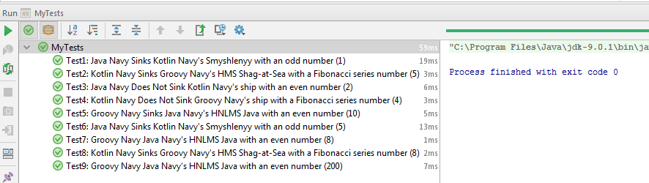
Retest to get to green

Slide 49
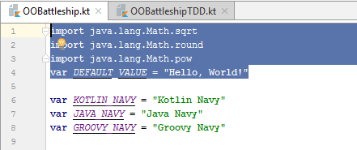
Refactor?
remove this

Slide 50
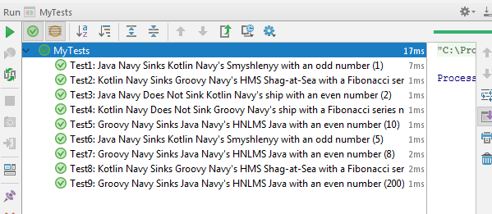
Retest to get to green

Slide 51
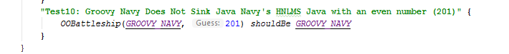
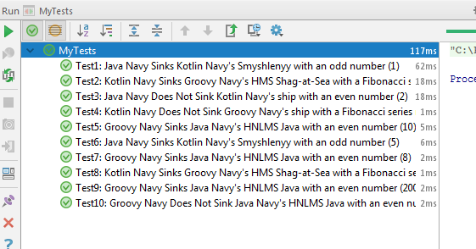
Ok, back to Red: Make a test case to fail,
but it worked without error

Slide 52
Keep testing until the testers are finished making cases

Slide 53
Data Driven Development, or “Refactor”
Not not doing the right thing-- efficiently

Slide 54
The basics: do this for each test case
Red. The “red” step is different for data driven development.
This part is the same: You have not written solution code yet. Based solely on your user requirements, you create a test case. This case will fail because you have not written solution code yet.
Why? The focus is on building a suite of tests which are specifically geared to test user requirements and nothing else.
If you do this first, you will not not do it.
This is different: You create a data set to represent test cases and expected results, then have one generic function for the code you are testing which takes this as input to test your code.
Why? Wouldn’t your QA team like to build test cases without writing code? Simply build your regression tests so that they can. Also: fewer lines of code.
{
“Open the pod bay
doors.”, “I'm sorry,
Dave. I'm afraid I
can't do that.”,
“Now that's what I
call a dead parrot.”
, “No, no.....No,
'e's stunned!”
}
}
This stays the same:

Slide 55
Not not doing something more efficiently means you do it-- more efficiently
1. You build a suite of test cases for each user requirement in a table structure which can be used for regression testing, and the business logic is structured so you can easily add test cases, modify existing test cases, delete test cases, or add forms to allow other people to do so.
2. This suite, because you built it, can be used for regression testing
3. You only commit code which passes all test cases in the suite
4. You only built code which was explicitly tied to a test case and a requirement

Slide 56
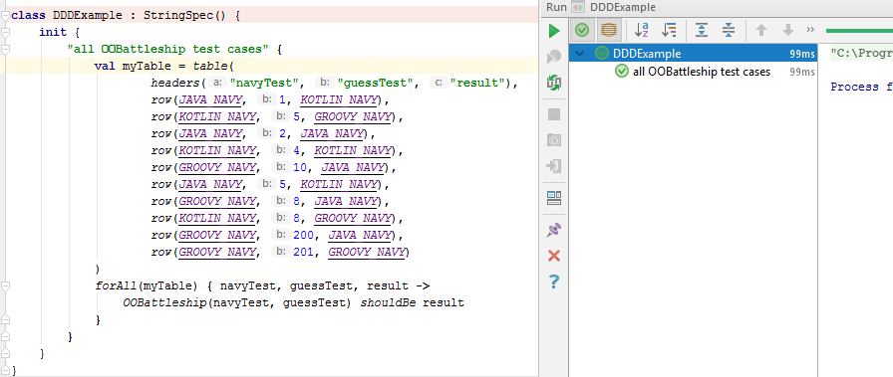
Data Driven Development: All the tests in one table

Slide 57
Imagine iterating through this for Test Driven Development: easier to read, and faster to create.

Slide 58
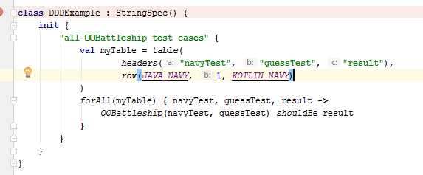
Wait, what? Same pattern: red, green, refactor
Except this time the testers just need to enter data in a table.
You create a table with your parameters and expected result, then hand it to your testers.

Slide 59
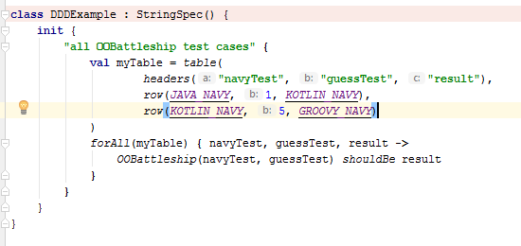
Each red, green, refactor step just involves
another entry in the test case table
rather than adding extra lines of code per test

Slide 60
Develop a large regression-test suite
using just tables of parameters
and expected results!
-- aka Data Driven Development, Parameterized Testing

Slide 61
Or just happy testers (bwah ha ha)

Slide 62
Not featured: klick
Move test cases to database
Load into DDD table from database
Provide UI for test case creation and editing to database
Tool to generate repetitive test cases into database
Hierarchical data structure in database to represent in a tree-structure the top level requirement broken down into more and more granular requirements, and finally into test cases for lowest level requirements [functions]

Slide 63
Thank you to the Kotlin Office Hours meetup team
for allowing me to present, and for creating a space welcoming to newcomers and experienced kotlin developers!
Thanks to Paul Reilly for presenting TDD for Kotlin in February to create a strong foundation for this presentation.
Special thanks also to Ethan Strominger
of Boston Software Craftsmanship
whose dojo and the katas we work on taught me everything I know about TDD and DDD!

Slide 64
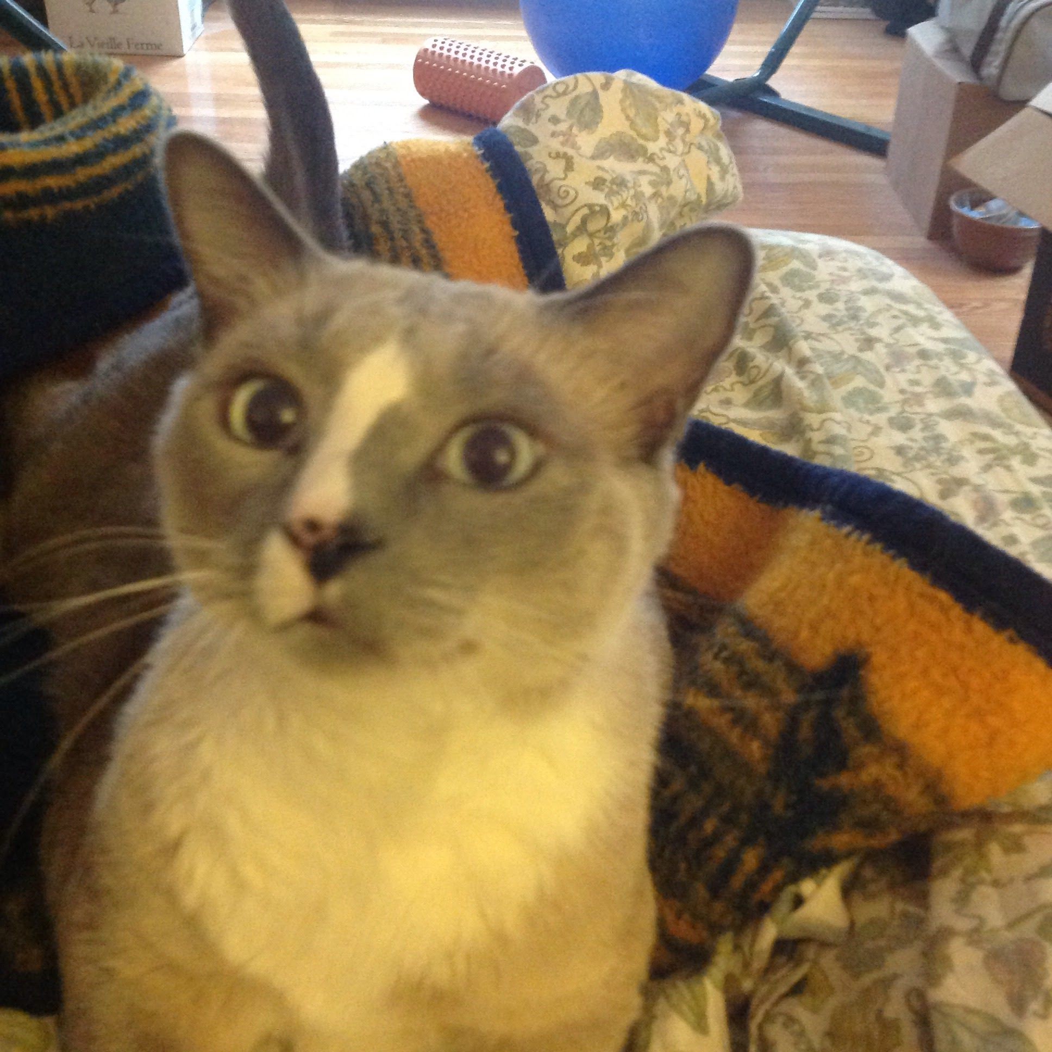
Erik Pohl
erik_pohl@hotmail.com
iotasubscript@gmail.com
Linked In: https://www.linkedin.com/in/erik-pohl-0792159/
GitHub:https://github.com/ErikPohl-Lot49-Projects/Erik-Pohl-Repo/tree/master/kotlin/kotlinTDDandDDD
The presenter is actively looking for a job to find interesting challenges to learn from with amazing folks.
My cat, Fritz, who helped a little with this slide deck.
(Fritz is actively not looking for a job.)

Slide 65
Links:
Kotlintest reference with excellent examples:
https://github.com/kotlintest/kotlintest
The importance of katas for practice and adoption:
http://www.peterprovost.org/blog/2012/05/02/kata-the-only-way-to-learn-tdd/

Slide 66
Have a nice Kotlin!
Thank you!

